Slide 1
浙江大学伊利诺伊大学厄巴纳香槟校区联合学院
Zhejiang University/University of Illinois at Urbana Champaign Institute
Team: ZJU-AI4H
Speaker: Zijie Meng
Ranking: Track 2 (Top2); Track 5 (Top5)

Slide 2
Content
Task Introduction
Method
Dataset Construction
Instruction Tuning (IT)
Post Training Quantization (PTQ)
Chain-of-Thought (CoT) Reasoning
Experiment & Discussion
https://github.com/fzp0424/EC-Guide-KDDUP-2024.git
https://huggingface.co/datasets/AiMijie/EC-Guide

Slide 3
Task Introduction
Track 2:
Task Format: Multiple Choice Question (MCQ); Retrieval
Skills: Numeric Reasoning; Commonsense Reasoning; Implicit, Multi-hop Reasoning
Track 5:
Task Format: Generation; Multiple Choice Question (MCQ); Retrieval; Ranking; Named Entity Recognition (NER)
Skills: Elaboration; Extraction; Summarization; Sentiment Analysis; Reasoning; Multi-lingual Scenarios...

Slide 4
Method | Pipeline
Construct EC-Guide by mining existing datasets and utilizing ChatGPT for data generation.
Embed e-commerce knowledge into LLMs.
Deploy powerful LLMs with quantization.
Integrate CoT heuristically to further boost LLM calculation performance.

Slide 5
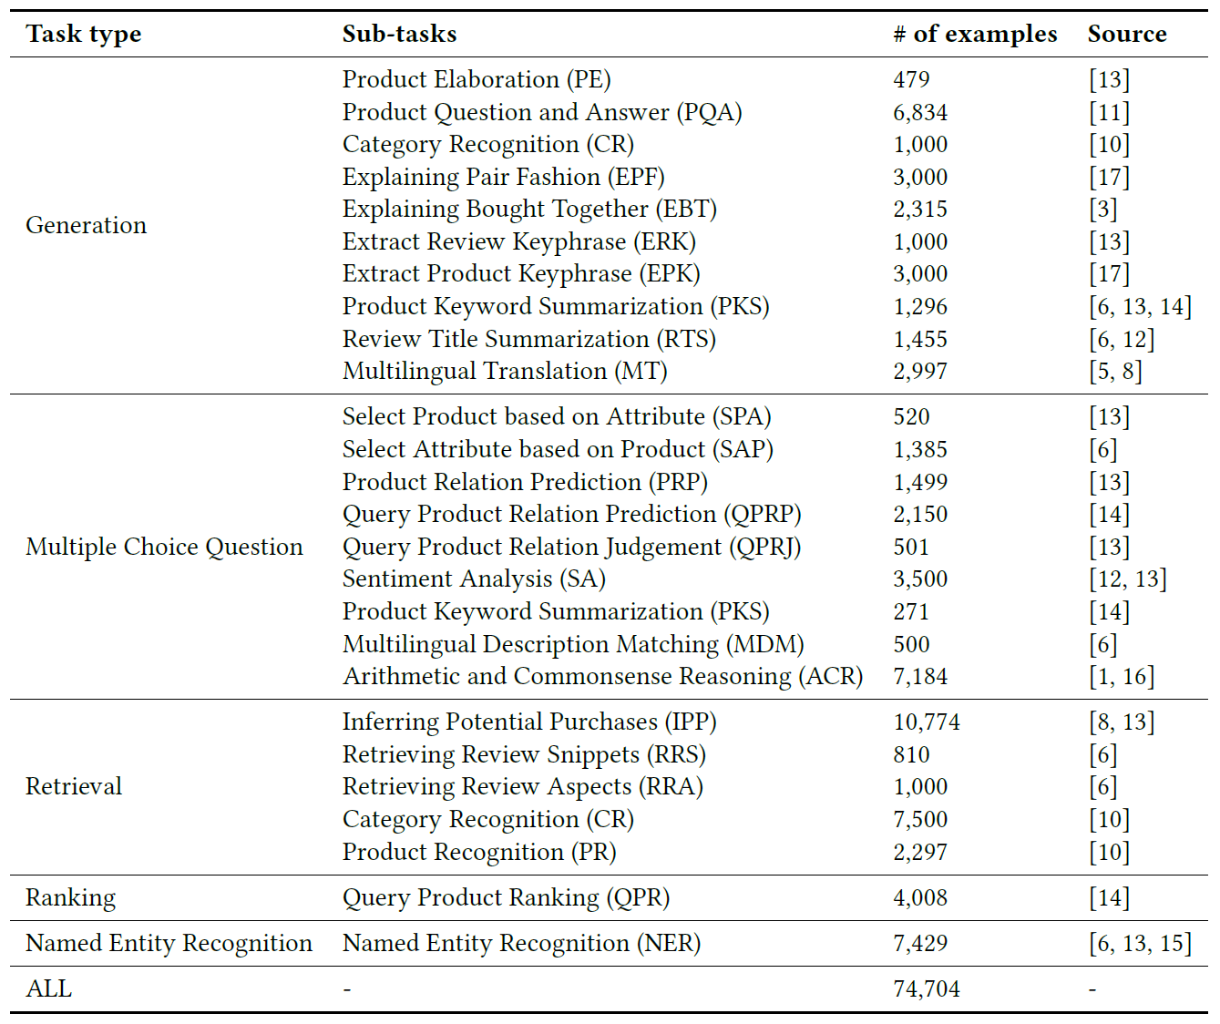
Method | EC-Guide Construction
Mine original data items from existing dataset to construction (e.g. EBT is from IntentionQA, EPK is from PFE dataset, ACR is from GSM8K and CMSQA, QPR is from Shopping Queries Dataset …).
Utilize ChatGPT to generate various subsets (e.g. generating detailed descriptions in PE, recognizing categories in CR, extracting aspect-keyphrase pairs in ERK, summarizing keywords in PKS, translating product titles for different languages in MT …).
Citation details can be seen in our paper.

Slide 6
Method | Instruction Tuning (IT)
Training set: $𝒟_{IT}={\left\{x^{\left(i\right)}, y^{\left(i\right)}\right\}}_{i=1}^{N}$
Instruction ($x$) | As a shopping assistant and language expert, you're tasked with analyzing a customer's query on an online store. Extract the key phrase mentioned in the query in terms of the entity type 'connectivity'. Do not give explanations. Query: nm-1000 noiseless wireless silent optical mouse usb noiseless dpi adjustable 5 button qnix. Output:
Label ($y$) | wireless
Target: Minimize the negative log-likelihood of the output $y$
$$ℒ\left(θ;𝒟_{IT}\right)=−𝔼_{\left(x,y\right)\sim 𝒟_{IT}}\left[\log{π_{θ}\left(y | x\right)}\right]$$

Slide 7
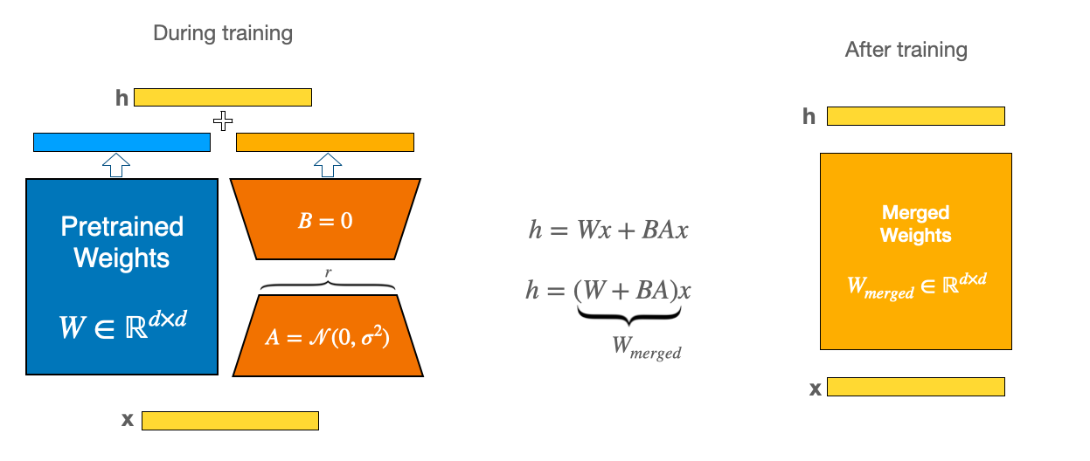
Method | Instruction Tuning (IT)
We applied low-rank adapters (LoRA) for all self-attention layers.
Represent the weight updates with two smaller matrices through low-rank decomposition.
Train new matrices while freezing original weight matrix.
Combine both the original and the adapted weights to produce the final results.

Slide 8
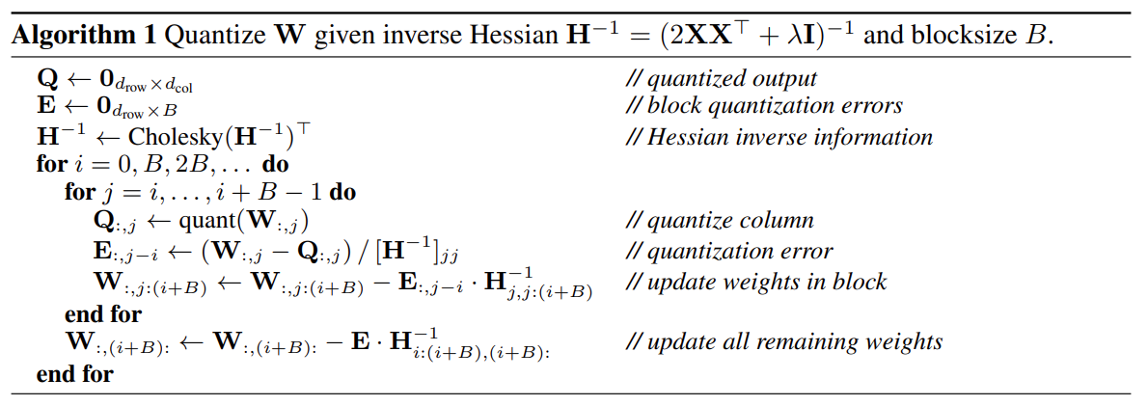
Method | Post Training Quantization (PTQ)
Post-Training Quantization (PTQ): Compress the model with GPTQ by a calibration dataset to accelerate inference and save memory.
Quantize each column of the weight matrix independently to minimize error.
Quantize weights to INT4 while keep activations in FLOAT16.
Dequantize weights dynamically in inference, with computation performed in float16.

Slide 9
Method | Post Training Quantization (PTQ)
1. Given a layer $l$ with weight matrix $W_{l}$ and layer input $X$, we want to find a quantized version of the weight ${\hat{W}}_{l}$ to minimize the mean squared error (MSE):
$${\hat{W}}_{l}^{∗}=argmin_{{\hat{W}}_{l}}{\left\|W_{l}X−{\hat{W}}_{l}X\right\|}_{2}^{2}$$
2. Once this is solved per layer, a solution to the global problem can be obtained by combining the layer-wise solutions.
Quantization Dataset | Case | Results
 |  | Track2-Dev. | Track5-Dev.
C4 sample | I thought I was going to finish the 3rd season of the Wire tonight. But there was a commentary on episode 11, so I had to re-watch Middle Ground with the commentary. Hopefully I can finish the season next weekend. | 0.6562 | 0.7017
EC-Guide sample | Explain the product type Vinyl. Output: Vinyl is a synthetic plastic material used for a wide range of products, including records, flooring, and upholstery, known for its durability, flexibility, and waterproof properties. | 0.7500 | 0.7403

Slide 10
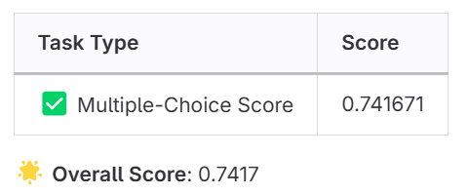
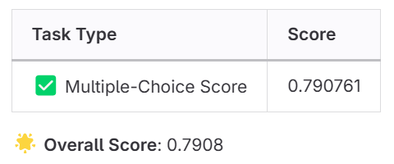
Method | Chain-of-Thought (CoT) Reasoning
(a) Vanilla
(b) CoT
Employ a heuristic strategy to determine if a question belong to arithmetic-based by counting the number of digits.
Prefix the prompt with “Let’s think step by step.”, stimulating the model to generate a rationale that leads to the correct answer.

Slide 11
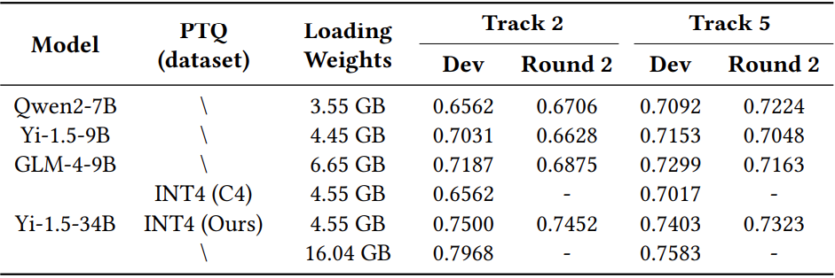
Experiment & Discussion
Table2: Results of various models under the same training settings. The loading weights are averaged across 4 GPU.
Q1: How does the model itself impact the results?
A1: Generally, newer models with larger parameter sizes often yield better results even after quantization.
Q2: Will more training data lead to better instruction tuning results?
A2: Our experimental results indicate that this is task-dependent. More fine-tuning data often leads to better outcomes in complex tasks. However, data quality and well-balanced sub-task mixture are more important for tasks with more uniform formats.
Table3: Results of submission with Yi-1.5-34B.
λ1 - Generation; λ2 - Multiple Choice Question (MCQ); λ3 - Retrieval; λ4 - Ranking; λ5- Named Entity Recognition (NER)

Slide 12
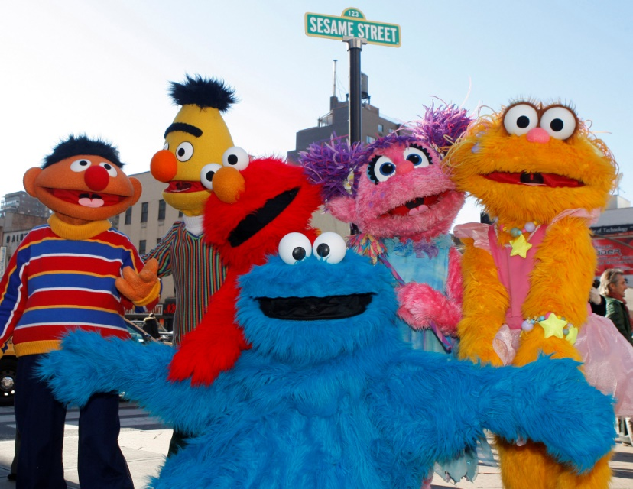
Thank you

